Slide 1
Machine LEARNING
FOUNDATIONS AND ALGORITHMS

Slide 2
WHAT IS MACHINE LEARNING?
“Field of study that gives computers the ability to learn without being explicitly programmed.”
- Arthur Samuel, IBM, 1959

Slide 3
WHAT IS MACHINE LEARNING?
“A Computer Program is said to learn from Experience E with respect to some class of tasks T and a performance measure P, if its performance at tasks in T, as measured by P, improves with Experience E.”
- Tom Mitchell, Carnegie Mellon University, 1997

Slide 4



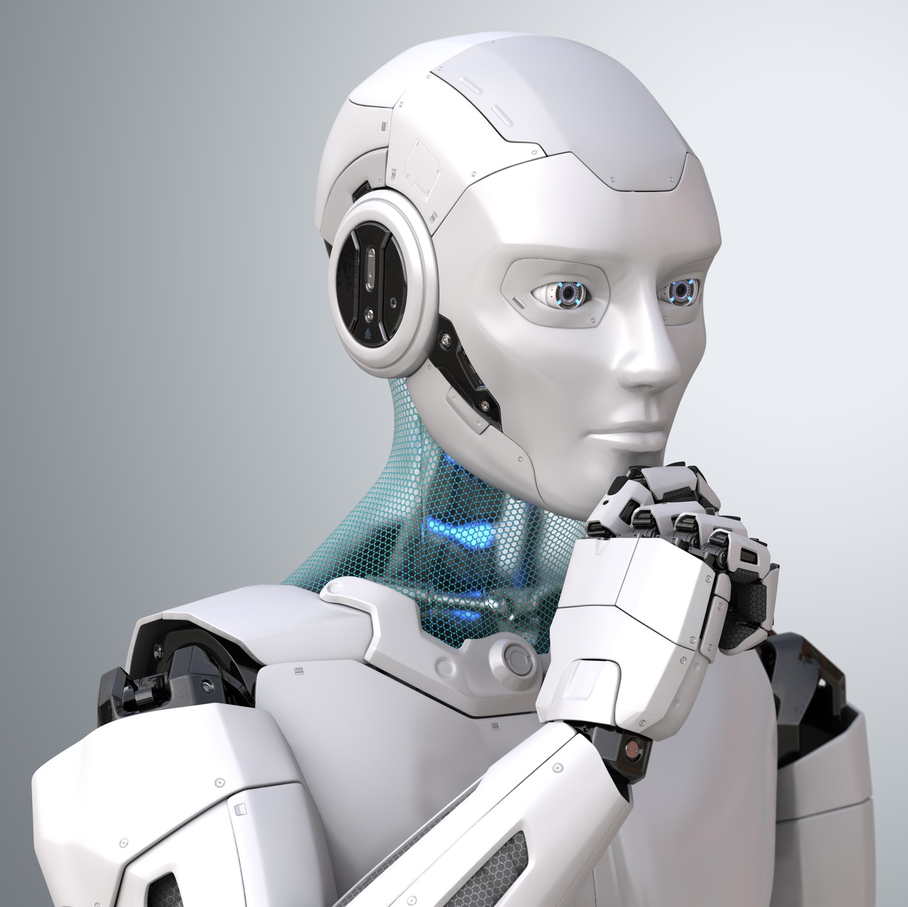
What is machine learning?
Learn from Experience
Learn from Experience data
Follow Instructions

Slide 5
Traditional vs machine learning
Traditional Programming
Machine Learning
Data
Program
Data
Output
Computer
Computer
Output
Program

Slide 6
When to use machine learning
ML is used when:
Human expertise does not exist (Navigating on Mars)
Humans can’t explain their expertise (Speech Recognition)
Models must be customized (Personalized Medicine)
Models are based on huge amount of data (Genomics)

Slide 7
machine learning PIPELINE

Slide 8
machine learning PIPELINE

Slide 9
machine learning TYPES

Slide 10
SUPERVISED LEARNING
Supervised machine learning algorithms are designed to learn by example.
The name “supervised” learning originates from the idea that training this type of algorithm is like having a teacher supervise the whole process.
When training a supervised learning algorithm, the training data will consist of inputs paired with the correct outputs.
During training, the algorithm will search for patterns in the data that correlate with the desired outputs.
After training, a supervised learning algorithm will take in new unseen inputs and will determine which label the new inputs will be classified as based on prior training data.
The objective of a supervised learning model is to predict the correct label for newly presented input data.
Two Common Types:
Regression
Classification

Slide 11
Unsupervised learning
Unsupervised learning is where you only have input data (X) and no corresponding output variables
The goal for unsupervised learning is to model the underlying structure or distribution in the data in order to learn more about the data.
These are called unsupervised learning because unlike supervised learning above there is no correct answers and there is no teacher. Algorithms are left to their own devises to discover and present the interesting structure in the data.
Unsupervised learning problems can be further grouped into clustering and association problems.
Clustering: A clustering problem is where you want to discover the inherent groupings in the data, such as grouping customers by purchasing behavior.
Association: An association rule learning problem is where you want to discover rules that describe large portions of your data, such as people that buy X also tend to buy Y.

Slide 12
Semi supervised learning
Problems where you have a large amount of input data (X) and only some of the data is labeled (Y) are called semi-supervised learning problems.
These problems sit in between both supervised and unsupervised learning.
A good example is a photo archive where only some of the images are labeled, (e.g. dog, cat, person) and the majority are unlabeled.
Many real world machine learning problems fall into this area. This is because it can be expensive or time-consuming to label data as it may require access to domain experts. Whereas unlabeled data is cheap and easy to collect and store.
You can use unsupervised learning techniques to discover and learn the structure in the input variables.
You can also use supervised learning techniques to make best guess predictions for the unlabeled data, feed that data back into the supervised learning algorithm as training data and use the model to make predictions on new unseen data.

Slide 13
Reinforcement learning
Reinforcement learning describes a class of problems where an agent operates in an environment and must learn to operate using feedback.
Reinforcement learning is learning what to do — how to map situations to actions—so as to maximize a numerical reward signal. The learner is not told which actions to take, but instead must discover which actions yield the most reward by trying them.
The use of an environment means that there is no fixed training dataset, rather a goal or set of goals that an agent is required to achieve, actions they may perform, and feedback about performance toward the goal.
An example of a reinforcement problem is playing a game where the agent has the goal of getting a high score and can make moves in the game and received feedback in terms of punishments or rewards.

Slide 14
Machine learning workflow

Slide 15
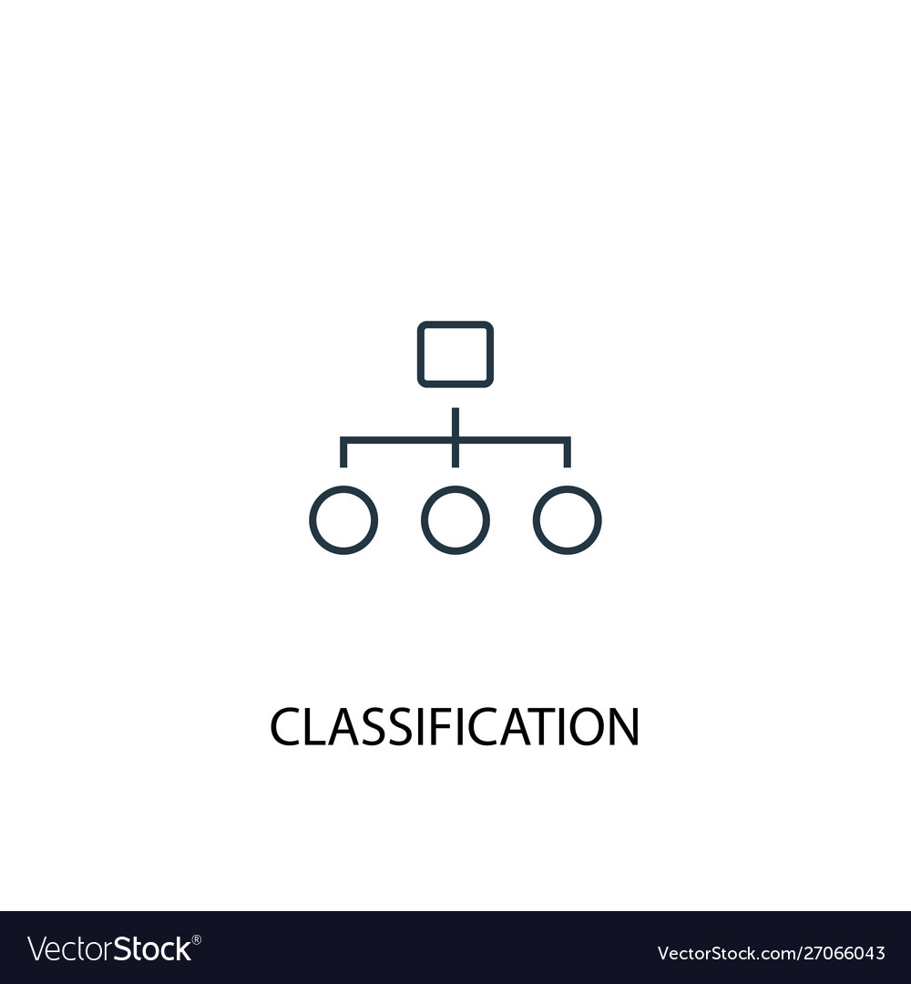
Classification use cases
Categorization
Email: Spam or Ham?
Stocks: Buy, Sell or Hold?
Images: Cat, Dog or Mouse?
Text: Positive, Negative or Neutral?
Weather: Sunny, Rainy or Windy?
Cricket: Loss or Win?
Medical Diagnosis: Positive or Negative?

Slide 16
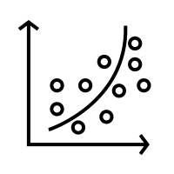
REGRession use cases
Predict Continuous Numeric Values
Email: Predict the number of emails
Stocks: Predict the price for tomorrow
Automobile: Predict Mileage
Real Estate: Predict the price of a land
Weather: Predict the amount of rainfall
Cricket: Predict runs scored by a player
REGRESSION

Slide 17
REGRESSION

Slide 18
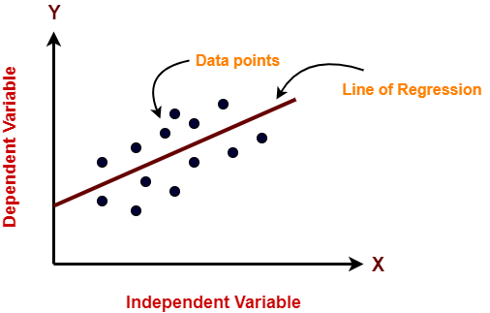
LINEAR REGRESSION

Slide 19
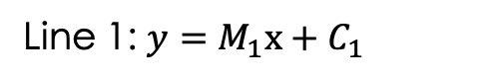
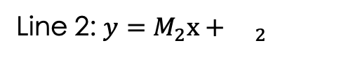
LINEAR REGRESSION
Minimizing Mean Square Error
Line 1: $y=M_{1}x+C_{1}$
Line 2: $y=M_{2}x+{}_{2}$
The “best fit” line is the one where the sum of the squares of the lengths of the dotted lines are minimum

Slide 20
DEMO
Linear Regression - Numerical Data
Linear Regression – Categorical Data

Slide 21
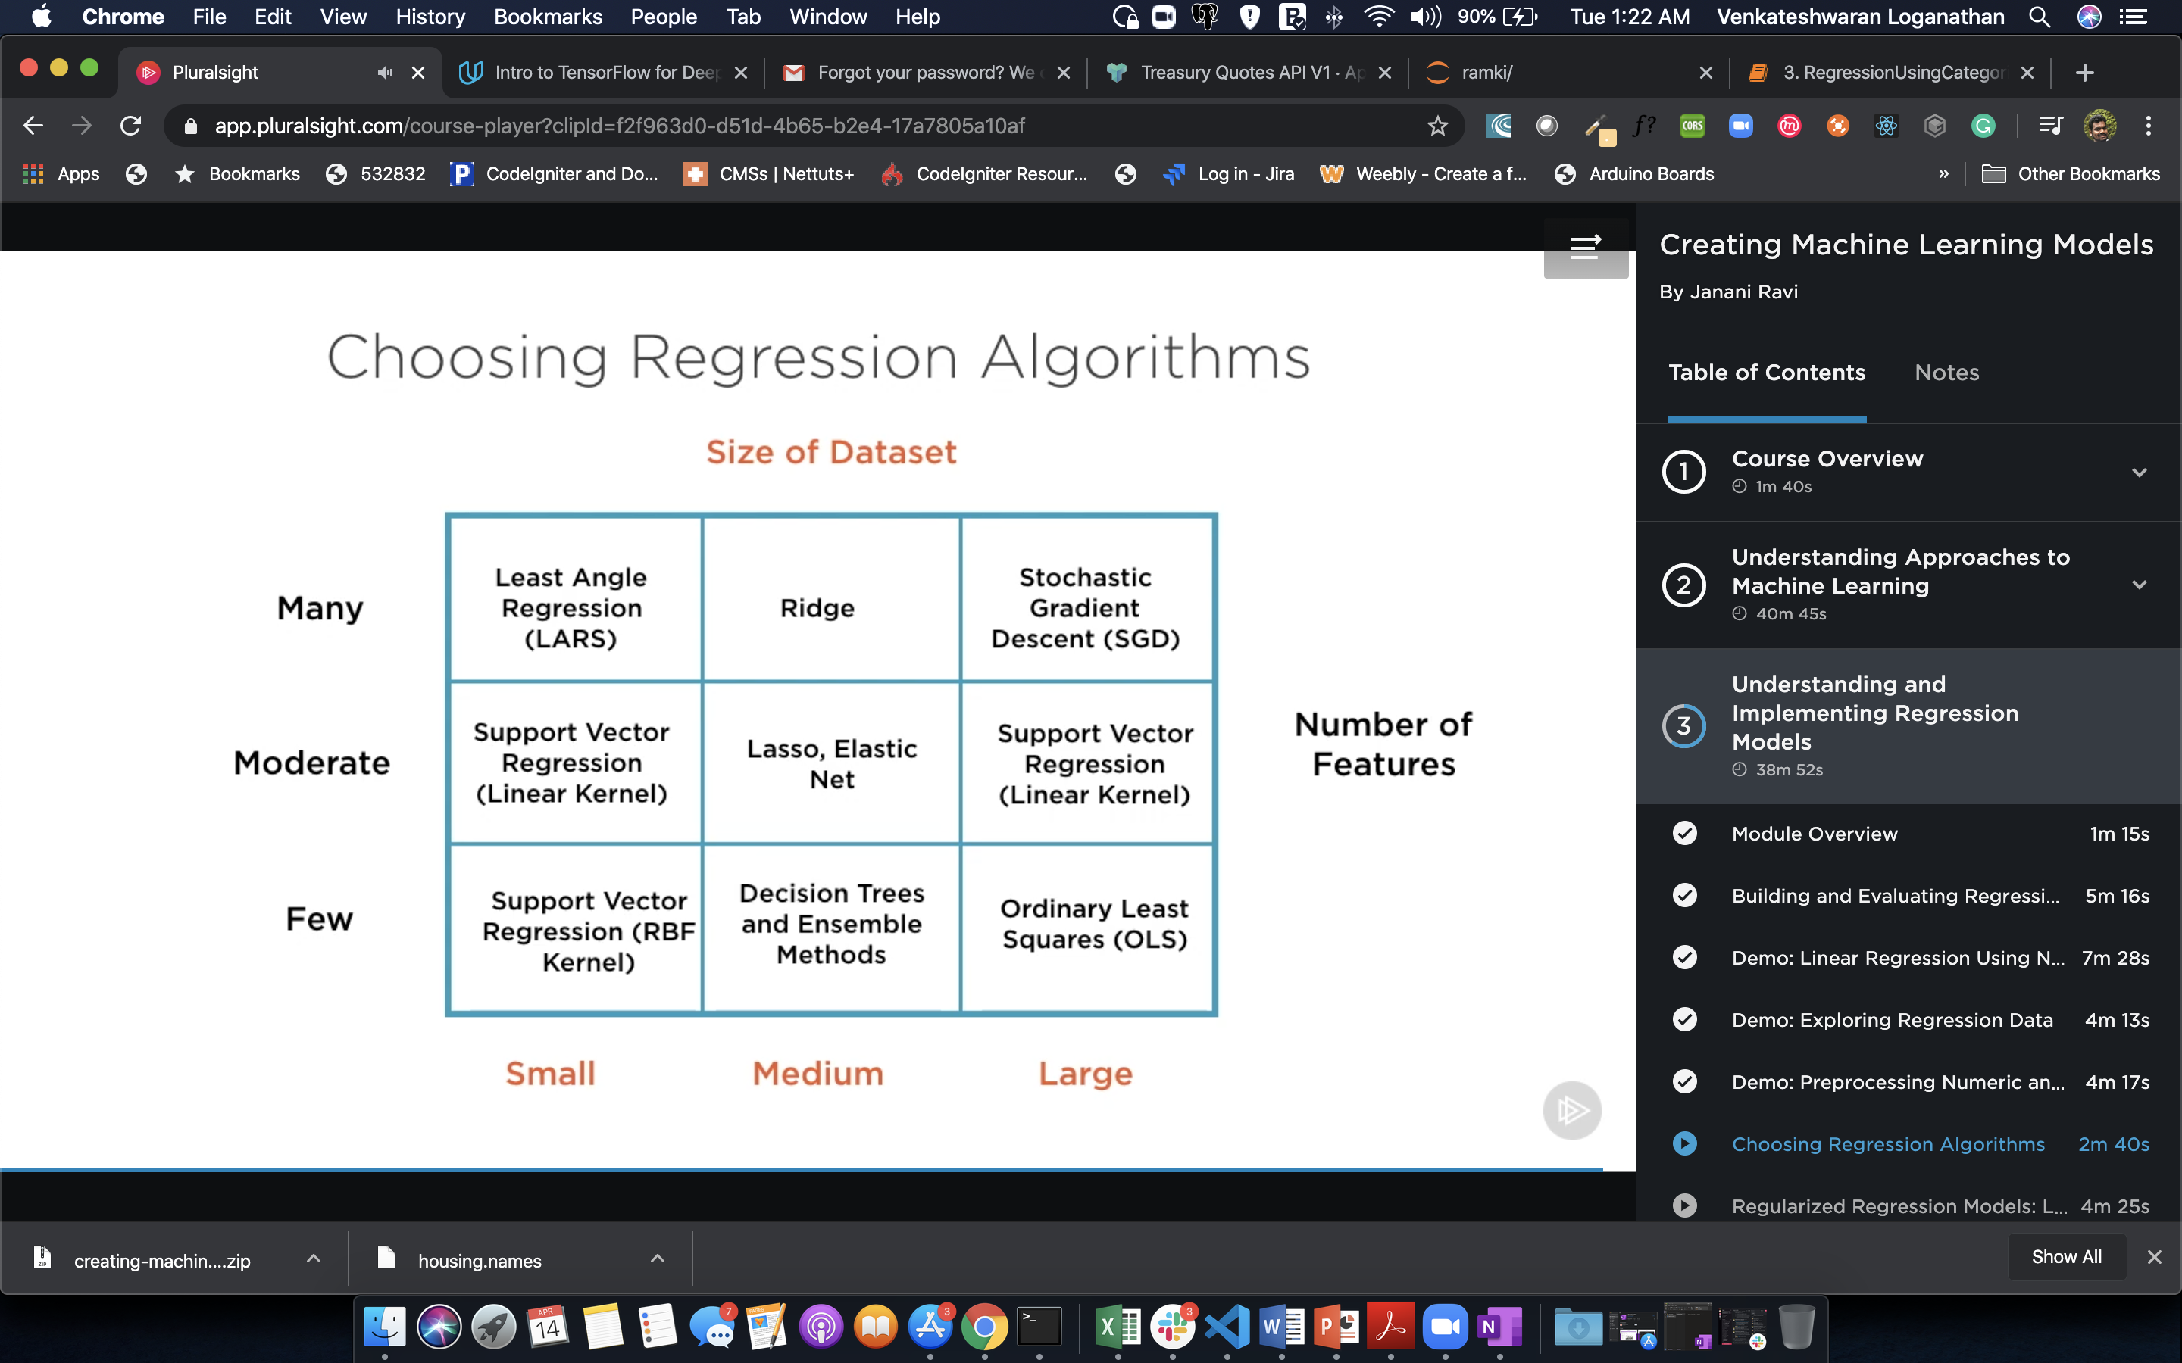
Choosing regression algorithms
https://scikit-learn.org/stable/modules/linear_model.html

Slide 22
REGULARISED REGRESSION MODELS
Lasso Regression
Ridge Regression
Elastic Net
Regression

Slide 23
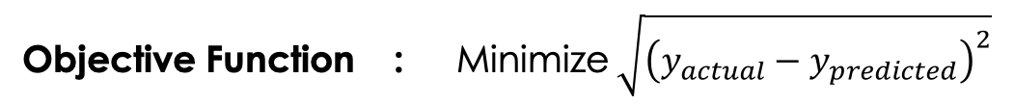
Ordinary MSE/OLS regression
Objective Function : Minimize $\sqrt{{\left(y_{actual}−y_{predicted}\right)}^{2}}$
Lasso Regression
Ridge Regression
Identify/Find : M – Slope and C - Intercept
The value of ‘M’ and ‘C’ still defines the ”best fit” line y = Mx + C

Slide 24
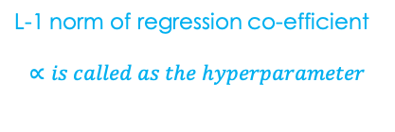
LASSO regression
Objective Function : Minimize $\sqrt{{\left(y_{actual}−y_{predicted}\right)}^{2}}$ + $α\left(\left|A\right|+\left|B\right|\right)$
L-1 norm of regression co-efficient
$$∝is called as the hyperparameter$$
Lasso Regression
Ridge Regression
Identify/Find : M – Slope and C - Intercept
The value of ‘M’ and ‘C’ still defines the ”best fit” line y = Mx + C

Slide 25
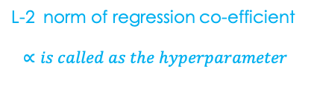
RIDGE regression
Objective Function : Minimize $\sqrt{{\left(y_{actual}−y_{predicted}\right)}^{2}}$ + $α\left({|A|}^{2}+{|B|}^{2}\right)$
L-2 norm of regression co-efficient
$$∝is called as the hyperparameter$$
Lasso Regression
Ridge Regression
Identify/Find : M – Slope and C - Intercept
The value of ‘M’ and ‘C’ still defines the ”best fit” line y = Mx + C

Slide 26
DEMO
Linear Regression
Lasso Regression
Ridge Regression
Stochastic Gradient Descent Regression

Slide 27
CLASSIFICATION

Slide 28
Types of classification
Binary : True/False – Logistic Regression, SVM
Multiclass : Digits, Alphabets - Logistic Regression
Multilabel : More than one label – Naïve Bayes
Multioutput : Multiclass + Multilabel
Lasso Regression
Ridge Regression

Slide 29
Logistic regression
Lasso Regression
Ridge Regression

Slide 30
Support vector machines
Lasso Regression
Ridge Regression

Slide 31
Nearest neighbours
Lasso Regression
Ridge Regression

Slide 32
UNSUPERVISED LEARNING
CLUSTERINGe Regression
Lasso Regression

Slide 33
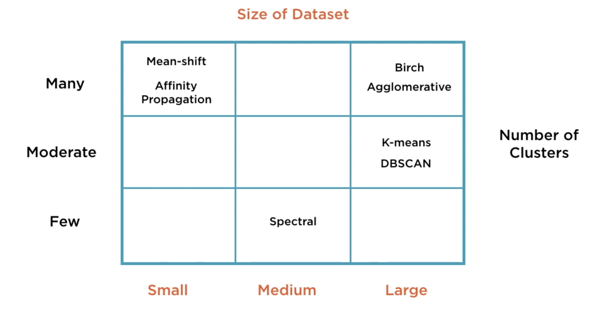
Choosing clustering algorithms
Lasso Regression
Ridge Regression

Slide 34
Types of clustering
Hierarchical
Centroid Based
Lasso Regression
Ridge Regression
Distribution Based
Density Based

Slide 35
K-Means clustering

Slide 36
Hierarchical clustering

